Slide 1
Definition
A graph G consists of two sets
a finite, nonempty set of vertices V(G)
a finite, possible empty set of edges E(G)
G(V,E) represents a graph
An undirected graph is one in which the pair of vertices in an edge is unordered, (v0, v1) = (v1,v0)
A directed graph is one in which each edge is a directed pair of vertices, <v0, v1> != <v1,v0>
tail
head

Slide 2
Examples for Graph
0
0
0
1
2
1
2
1
3
3
4
5
6
G1
2
G2
complete graph
incomplete graph
G3
V(G1)={0,1,2,3} E(G1)={(0,1),(0,2),(0,3),(1,2),(1,3),(2,3)}
V(G2)={0,1,2,3,4,5,6} E(G2)={(0,1),(0,2),(1,3),(1,4),(2,5),(2,6)}
V(G3)={0,1,2} E(G3)={<0,1>,<1,0>,<1,2>}
complete undirected graph: n(n-1)/2 edges

Slide 3
Complete Graph
A complete graph is a graph that has the maximum number of edges
for undirected graph with n vertices, the maximum number of edges is n(n-1)/2
for directed graph with n vertices, the maximum number of edges is n(n-1)
example: G1 is a complete graph

Slide 4
Degree
The degree of a vertex is the number of edges incident to that vertex
For directed graph,
the in-degree of a vertex v is the number of edges that have v as the head
the out-degree of a vertex v is the number of edges that have v as the tail

Slide 5
undirected graph
degree
3
0
0
2
1
2
3
1
2
3
3
3
3
4
5
6
3
3
1
G1
1
G2
1
1
0
in:1, out: 1
directed graph
in-degree
out-degree
1
in: 1, out: 2
2
in: 1, out: 0
G3

Slide 6
Path
A path can be defined as the sequence of nodes that are followed in order to reach some terminal node V from the initial node U.
Closed Path
A path will be called as closed path if the initial node is same as terminal node. A path will be closed path if V₀=V_{N}.
Simple Path
If all the nodes of the graph are distinct with an exception V₀=V_{N}, then such path P is called as closed simple path.
Cycle
A cycle can be defined as the path which has no repeated edges or vertices except the first and last vertices.
Connected Graph
A connected graph is the one in which some path exists between every two vertices (u, v) in V. There are no isolated nodes in connected graph.
Complete Graph
A complete graph is the one in which every node is connected with all other nodes. A complete graph contain n(n-1)/2 edges where n is the number of nodes in the graph.

Slide 7
Weighted Graph
In a weighted graph, each edge is assigned with some data such as length or weight. The weight of an edge e can be given as w(e) which must be a positive (+) value indicating the cost of traversing the edge.
Digraph
A digraph is a directed graph in which each edge of the graph is associated with some direction and the traversing can be done only in the specified direction.
Loop
An edge that is associated with the similar end points can be called as Loop.
Adjacent Nodes
If two nodes u and v are connected via an edge e, then the nodes u and v are called as neighbours or adjacent nodes.
Degree of the Node
A degree of a node is the number of edges that are connected with that node. A node with degree 0 is called as isolated node.

Slide 8
Graph Representations
Adjacency Matrix
Adjacency Lists

Slide 9
Sequential representation (or, Adjacency matrix representation)
In sequential representation, there is a use of an adjacency matrix to represent the mapping between vertices and edges of the graph. We can use an adjacency matrix to represent the undirected graph, directed graph, weighted directed graph, and weighted undirected graph.
If adj[i][j] = w, it means that there is an edge exists from vertex i to vertex j with weight w.
An entry A_{ij} in the adjacency matrix representation of an undirected graph G will be 1 if an edge exists between V_{i} and V_{j}. If an Undirected Graph G consists of n vertices, then the adjacency matrix for that graph is n x n, and the matrix A = [aij] can be defined as -
a_{ij} = 1 {if there is a path exists from V_{i} to V_{j}}
a_{ij} = 0 {Otherwise}

Slide 10
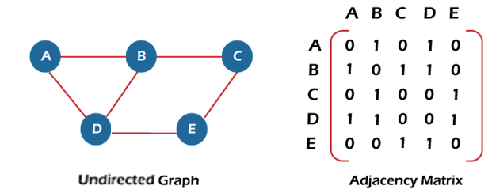

Slide 11
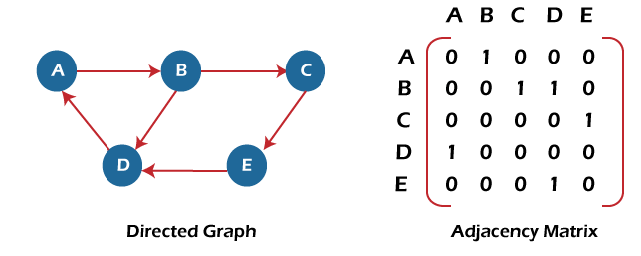
Adjacency matrix for a directed graph

Slide 12

Adjacency matrix for a weighted directed graph

Slide 13
Linked list representation
An adjacency list is used in the linked representation to store the Graph in the computer's memory. It is efficient in terms of storage as we only have to store the values for edges.

Slide 14
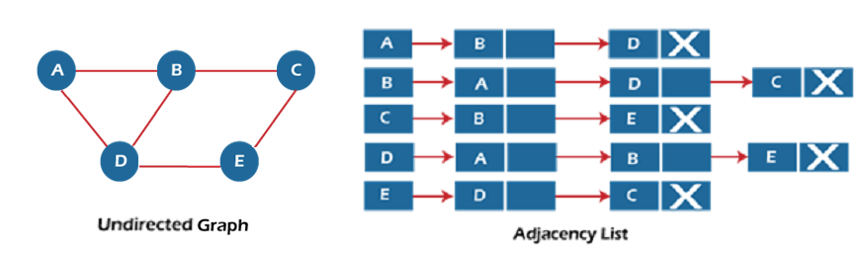
Adjacency Lists Representation Of Undirected Graph

Slide 15
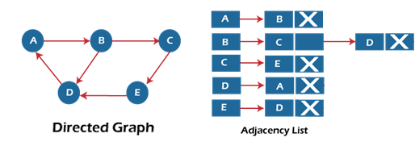
Adjacency Lists Representation Of directed Graph

Slide 16
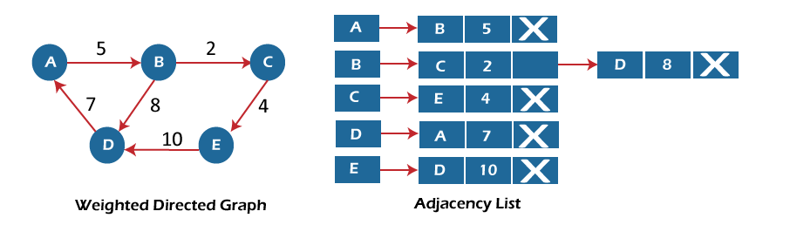
Adjacency Lists Representation Of Weighted Graph

Slide 17
Graph Traversal
BFS
DFS

Slide 18
BFS
Breadth First Search-
Breadth First Search or BFS is a graph traversal algorithm.
It is used for traversing or searching a graph in a systematic fashion.
BFS uses a strategy that searches in the graph in breadth first manner whenever possible.
Queue data structure is used in the implementation of breadth first search.

Slide 19
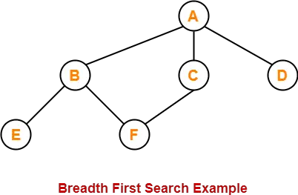

Slide 20
The breadth first search traversal order of the above graph is-
A, B, C, D, E, F
BFS Time Complexity-
The total running time for Breadth First Search is O (V+E).

Slide 21
Depth First Search (DFS)
The DFS algorithm is a recursive algorithm that uses the idea of backtracking. It involves exhaustive searches of all the nodes by going ahead, if possible, else by backtracking.
Here, the word backtrack means that when we are moving forward and there are no more nodes along the current path, we move backwards on the same path to find nodes to traverse. All the nodes will be visited on the current path till all the unvisited nodes have been traversed after which the next path will be selected.
This recursive nature of DFS can be implemented using stacks. The basic idea is as follows: Pick a starting node and push all its adjacent nodes into a stack. Pop a node from stack to select the next node to visit and push all its adjacent nodes into a stack. Repeat this process until the stack is empty. However, ensure that the nodes that are visited are marked. This will prevent us from visiting the same node more than once. If we do not mark the nodes that are visited and we visit the same node more than once, we may end up in an infinite loop.

Slide 22
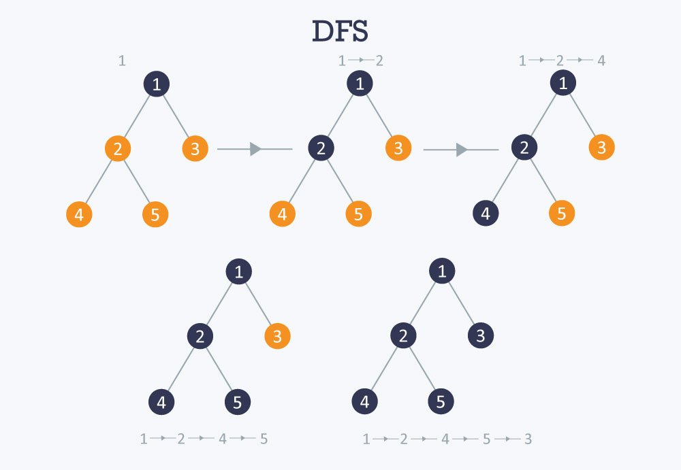

Slide 23
Time complexity O (V+E). when implemented using an adjacency list.

Slide 24
Spanning Tree
Spanning Tree
Given an undirected and connected graph G(V,E), a spanning tree of the graph G is a tree that spans G (that is, it includes every vertex of G) and is a subgraph of G (every edge in the tree belongs to G)
Minimum Spanning Tree
The cost of the spanning tree is the sum of the weights of all the edges in the tree. There can be many spanning trees. Minimum spanning tree is the spanning tree where the cost is minimum among all the spanning trees. There also can be many minimum spanning trees.
Minimum spanning tree has direct application in the design of networks. It is used in algorithms approximating the travelling salesman problem, multi-terminal minimum cut problem and minimum-cost weighted perfect matching. Other practical applications are:
Cluster Analysis
Handwriting recognition
Image segmentation

Slide 25
Kruskal’s Algorithm
Algorithm Steps:
Sort the graph edges with respect to their weights.
Start adding edges to the MST from the edge with the smallest weight until the edge of the largest weight.
Only add edges which doesn't form a cycle , edges which connect only disconnected components.

Slide 26
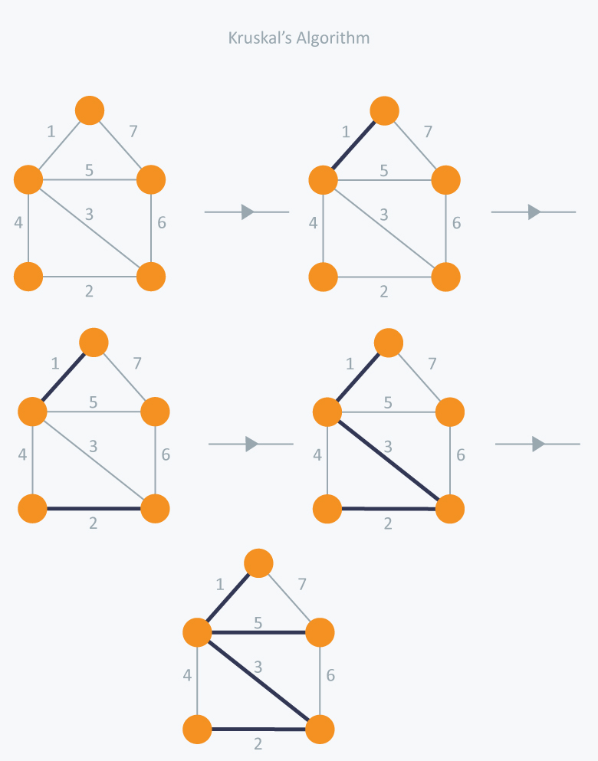

Slide 27
minimum spanning tree with total cost 11 ( = 1 + 2 + 3 + 5).
Time Complexity: In Kruskal’s algorithm, most time consuming operation is sorting because the total complexity of the Disjoint-Set operations will be O(ElogV), which is the overall Time Complexity of the algorithm.

Slide 28
Prim’s Algorithm
Prim’s Algorithm also use Greedy approach to find the minimum spanning tree. In Prim’s Algorithm we grow the spanning tree from a starting position. Unlike an edge in Kruskal's, we add vertex to the growing spanning tree in Prim's.
Algorithm Steps:
Maintain two disjoint sets of vertices. One containing vertices that are in the growing spanning tree and other that are not in the growing spanning tree.
Select the cheapest vertex that is connected to the growing spanning tree and is not in the growing spanning tree and add it into the growing spanning tree. This can be done using Priority Queues. Insert the vertices, that are connected to growing spanning tree, into the Priority Queue.
Check for cycles. To do that, mark the nodes which have been already selected and insert only those nodes in the Priority Queue that are not marked.

Slide 29
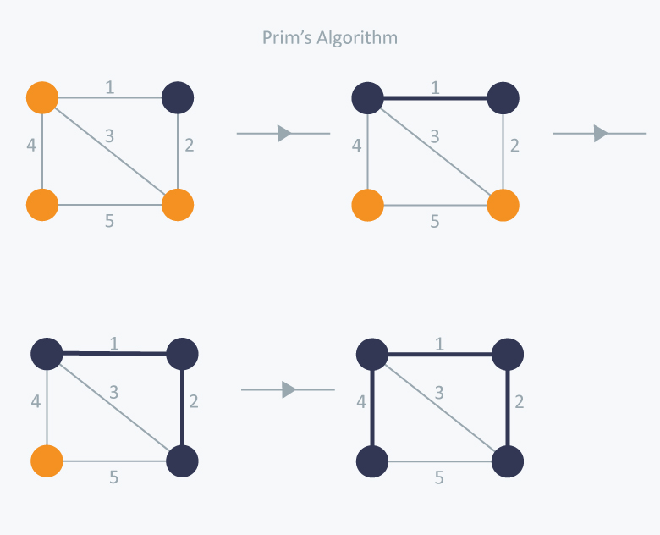

Slide 30
the minimum spanning tree of total cost 7 ( = 1 + 2 +4).
Time Complexity: The time complexity of the Prim’s Algorithm is O((V+E)logV) because each edge is inserted in the priority queue only once and insertion in priority queue take logarithmic time.

